Slide 1
NAME 338
Ship Design Project and Presentation
Under the supervision of
Dr. Md. Mashiur Rahaman
Professor
Naval Architecture & Marine Engineering, BUET
Presented By:
Sakibul Hasan Nahid: 1612046
Md. Riasat Morshed Khan:1612047

Slide 2
Name of the project
Design of 2000 DWT GL class Oil Tanker for operation in the inland waterways of Bangladesh
Principle Particulars | Value | Unit
Length overall, L_{OA} | 73.75 | meter
Length between perpendiculars, L_{BP} | 70.80 | meter
Breadth, B | 11.42 | meter
Depth, D | 5.70 | meter
Draft, T | 4.40 | meter
Block co-efficient, C_{B} | 0.75 | --
Speed, V | 10 | knot

Slide 3
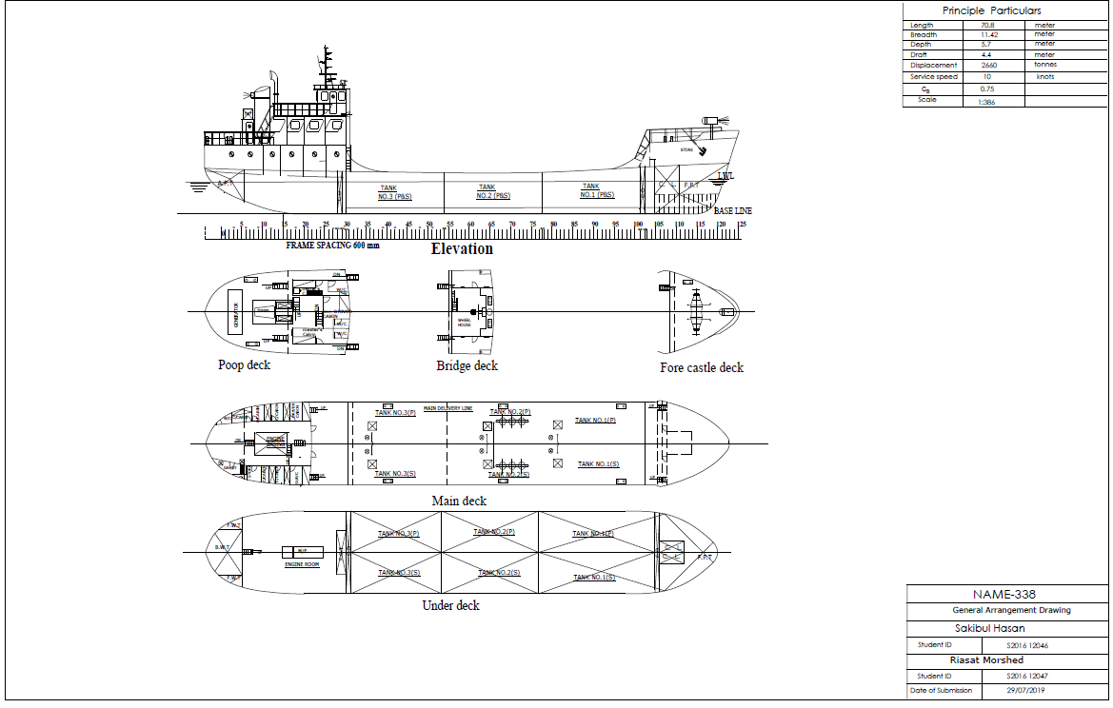
General arrangement drawing

Slide 4
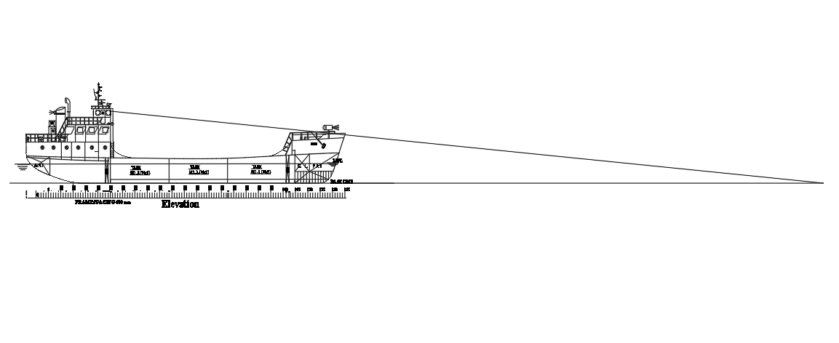
Visibility Test

Slide 5
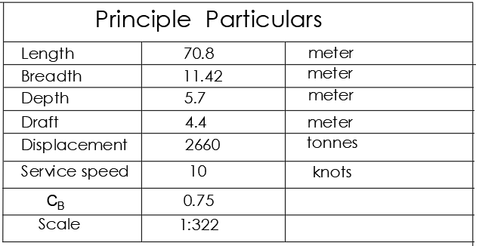
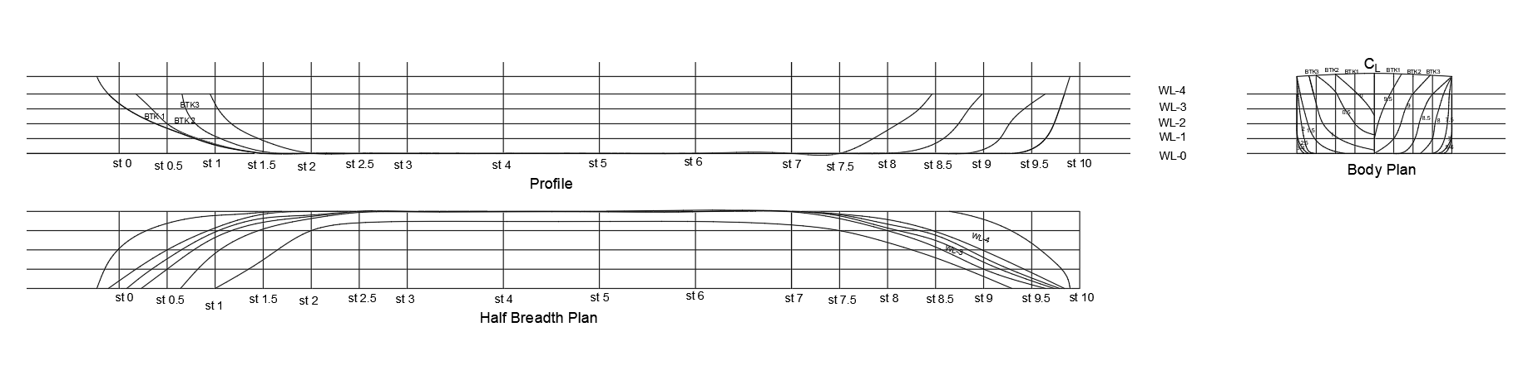
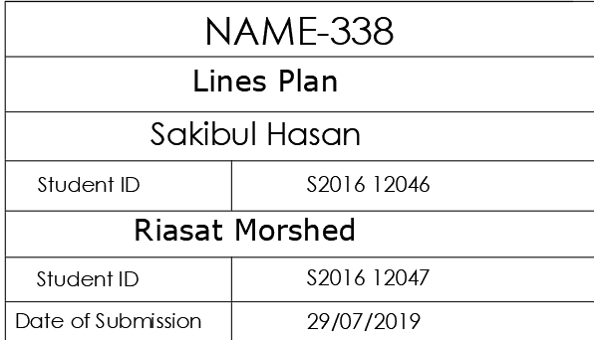
Lines plan

Slide 6
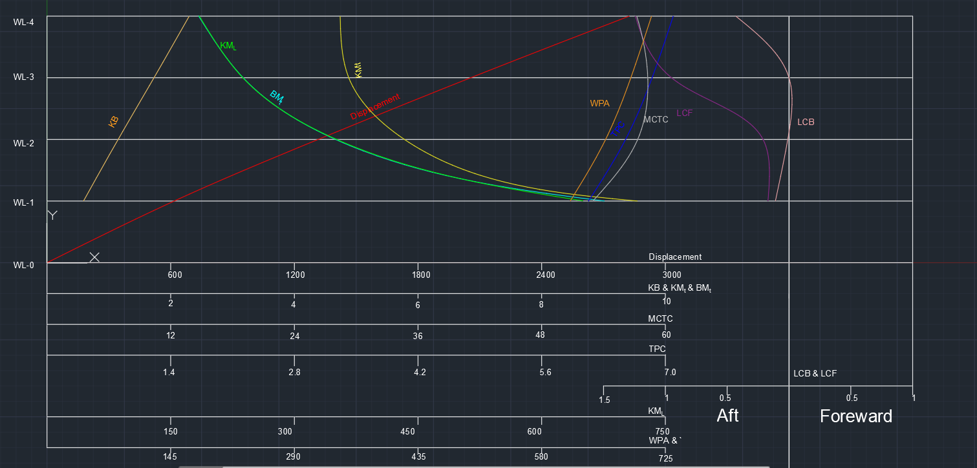
Hydrostatic parameters & hydrostatic curve:
Draft(m) | TPC(ton) | LCB(m) | KB(m) | Displacement (tonnes) | BM_{L}(m) | BM_{T}(m) | MCTC(N-m) | KM_{L}(m) | KM_{T}(m) | LCF abt aft(m)
1.10 | 6.13 | 35.29 | 0.59 | 61.61 | 608.25 | 8.96 | 52.97 | 643.54 | 9.55 | 35.23
2.20 | 6.55 | 35.39 | 1.15 | 1315.50 | 308.48 | 4.64 | 57.32 | 343.87 | 5.78 | 35.19
3.30 | 6.85 | 35.40 | 1.73 | 2055.11 | 195.12 | 3.15 | 56.64 | 230.53 | 4.88 | 34.45
4.40 | 7.09 | 34.97 | 2.30 | 2659.09 | 143.46 | 2.44 | 57.23 | 178.43 | 4.74 | 34.07

Slide 7
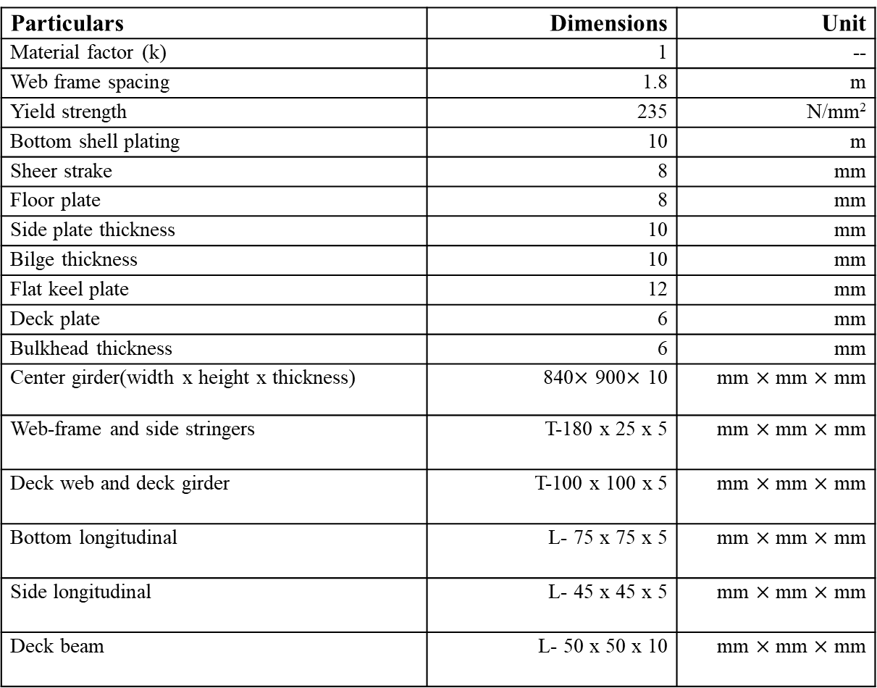
Summary of scantling calculation
Particulars | Dimensions | Unit
Material factor (k) | 1 | --
Web frame spacing | 1.8 | m
Yield strength | 235 | N/mm²
Bottom shell plating | 10 | m
Sheer strake | 8 | mm
Floor plate | 8 | mm
Side plate thickness | 10 | mm
Bilge thickness | 10 | mm
Flat keel plate | 12 | mm
Deck plate | 6 | mm
Bulkhead thickness | 6 | mm
Center girder(width x height x thickness) | 840$×$ 900$×$ 10 | mm $×$ mm $×$ mm
Web-frame and side stringers | T-180 x 25 x 5 | mm $×$ mm $×$ mm
Deck web and deck girder | T-100 x 100 x 5 | mm $×$ mm $×$ mm
Bottom longitudinal | L- 75 x 75 x 5 | mm $×$ mm $×$ mm
Side longitudinal | L- 45 x 45 x 5 | mm $×$ mm $×$ mm
Deck beam | L- 50 x 50 x 10 | mm $×$ mm $×$ mm
Reference:
1.Germanischer Lloyd(GL)
2. United States Steel (USS) Structural Sections Book

Slide 8
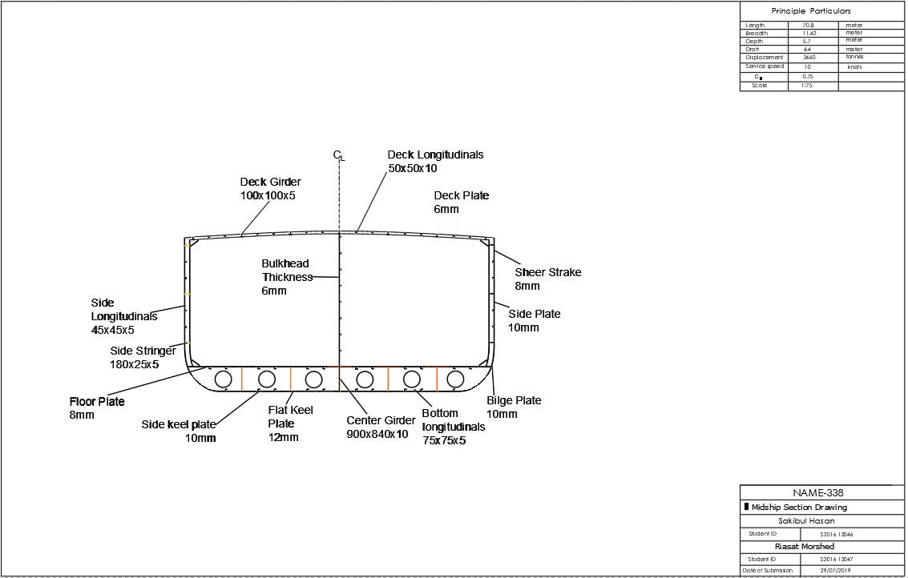
Midship section drawing

Slide 9
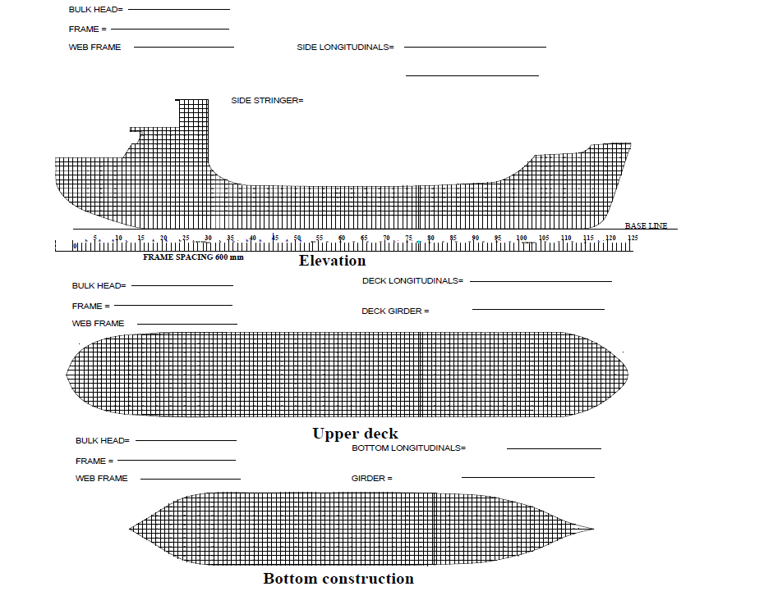
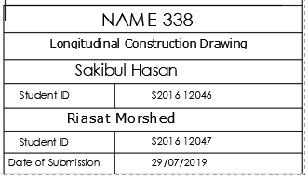
Longitudinal construction

Slide 10
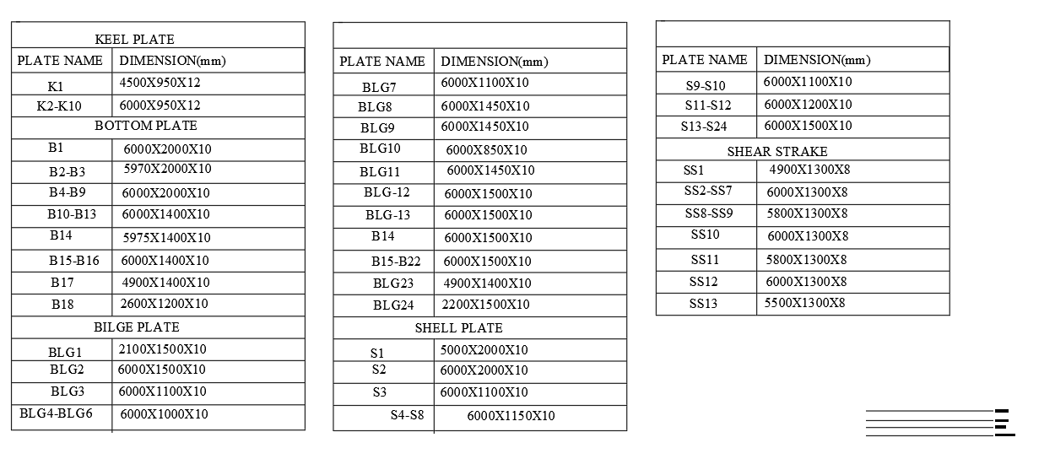
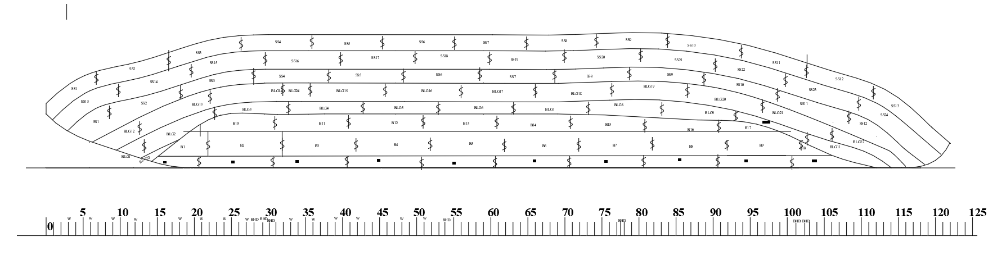
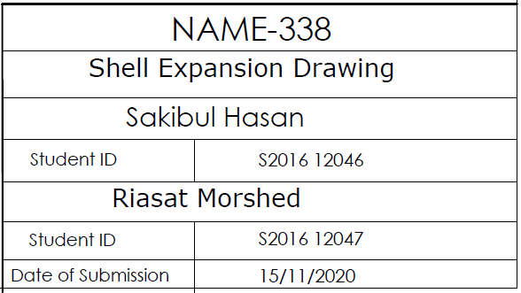
Shell expansion drawing

Slide 11
Summary of resistance calculation
Resistance component | Value | Unit
Frictional resistance | 54.40 | kN
Appendage resistance | 0.77 | kN
Wave resistance | 38.47 | kN
Additional pressure resistance due to bulbous bow | 0 | kN
Additional pressure resistance of immersed transom stern | 0 | kN
Model-ship co-relation resistance | 9.30 | kN
Wind resistance | 9.00 | kN
Total resistance | 102.64 | kN

Slide 12
Summary of power calculation
Power Component | Value | Unit
Effective Power, P_{E} | 579.24 | kW
Developed Power, P_{D} | 1053.16 | kW
Break Power, P_{B} | 1074.65 | kW
Installed Power | 1265 | kW

Slide 13
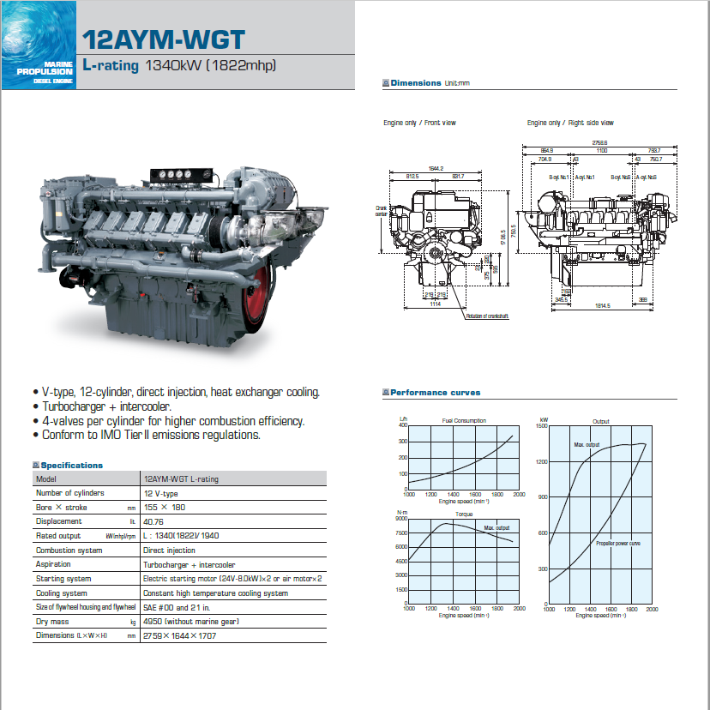
Engine selection
From “Yanmar Catalogue for Marine Diesel Engine”, the engine chosen is:

Slide 14
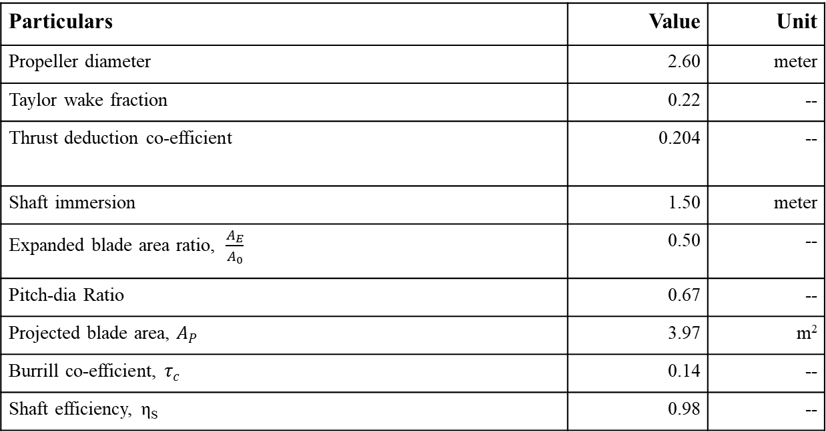
Summary of propeller calculation:
Particulars | Value | Unit
Propeller diameter | 2.60 | meter
Taylor wake fraction | 0.22 | --
Thrust deduction co-efficient | 0.204 | --
Shaft immersion | 1.50 | meter
Expanded blade area ratio, $\frac{A_{E}}{A_{0}}$ | 0.50 | --
Pitch-dia Ratio | 0.67 | --
Projected blade area, $A_{P}$ | 3.97 | m²
Burrill co-efficient, $τ_{c}$ | 0.14 | --
Shaft efficiency, η_{S} | 0.98 | --
1.The vessel is single-screw vessel and the propeller is of 3 blades.
2. The geometry of the propeller is drawn from Wageningen
B-screw propeller.
3. Cavitation criteria from Burril’s chart was calculated and was proved to be lower than the
upper limit for merchant vessel.

Slide 15
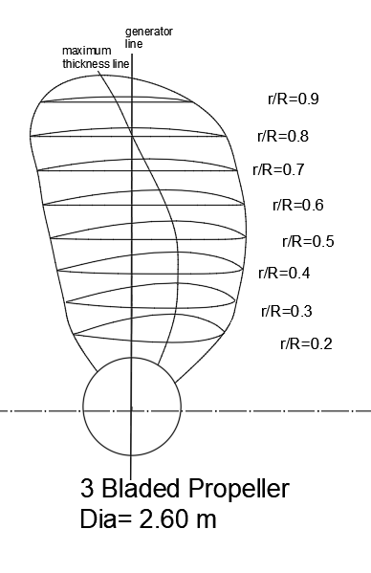
Propeller Profile:

Slide 16
Summary of engine room foundation calculation
Items | Dimension | Unit
Thickness of floor plate | 8 | mm
Center girder thickness | 10 | mm
Center girder height | 870 | mm
Thickness of longitudinal girder | 15 | mm
Top plate area | 81.68 | cm²
Thickness of center girder | 10 | mm
Inner bottom plate | 8 | mm
Web frame | T-180 x 25 x 5 | mm x mm x mm
Top plate thickness | 32 | mm
Bolt diameter | 32 | mm

Slide 17
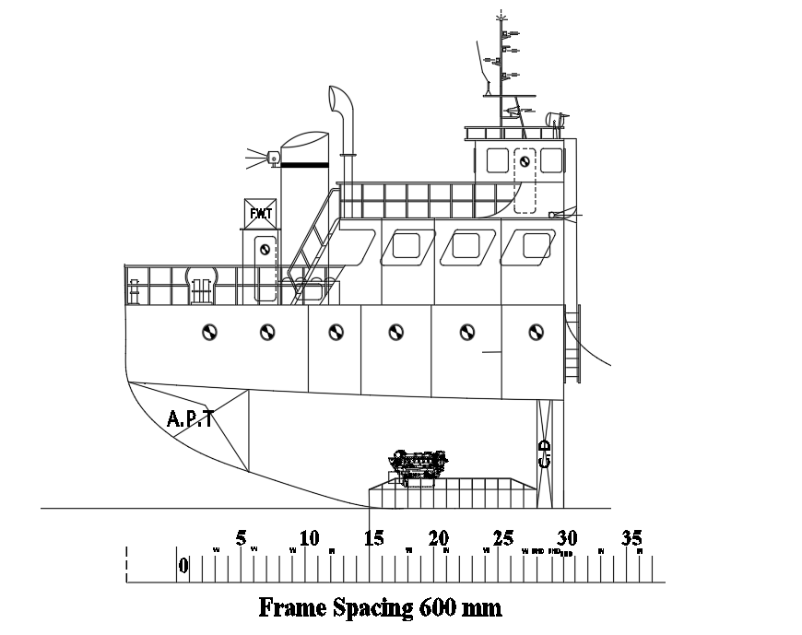
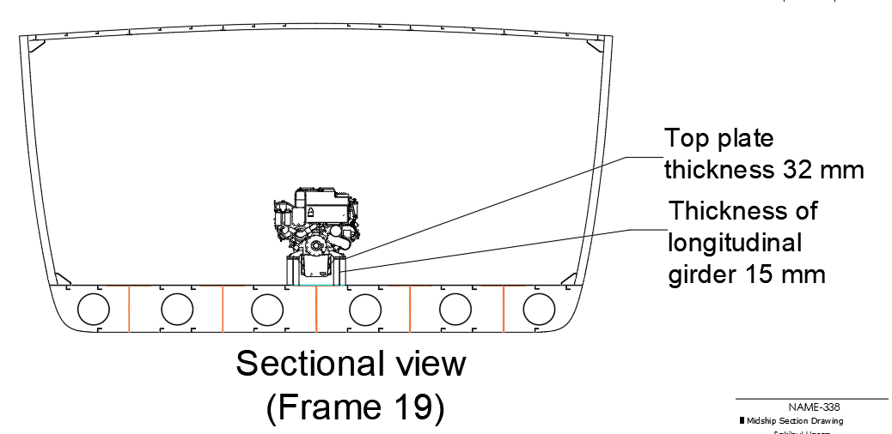
Engine room foundation drawing

Slide 18
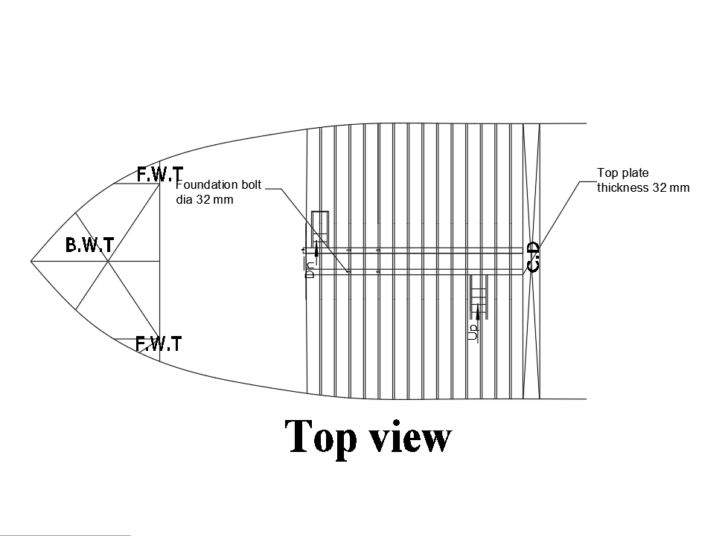
Top view for engine room foundation:

Slide 19
Summary of Rudder Calculation:
Item | Dimension | Unit
Rudder area | 8.52 | m²
Aspect ratio | 1.2 | --
Stock dia | 100 | mm
Distance of the bolt axis from the center of the bolt system | 105 | mm
No. Of bolts | 6 | --
Coupling dia | 25 | mm
Thickness of coupling flanges | 22.5 | mm
Thickness of coupling flange clear of bolt hole | 16.25 | mm
Thickness of rudder plating | 10 | mm
Thickness of the webs | 7 | mm
Diameter of pintle | 113 | mm

Slide 20
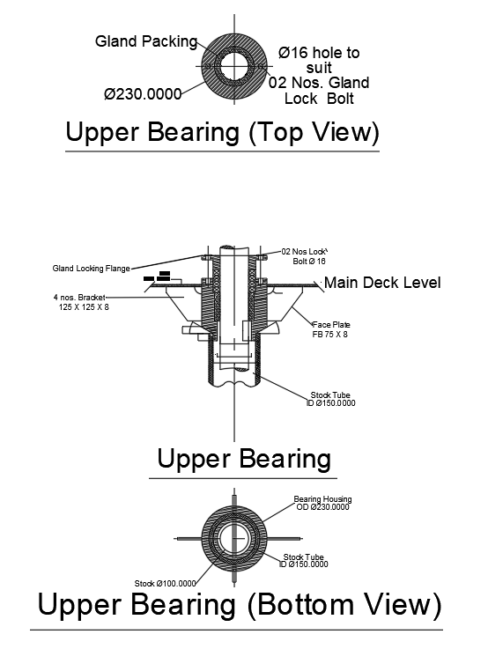
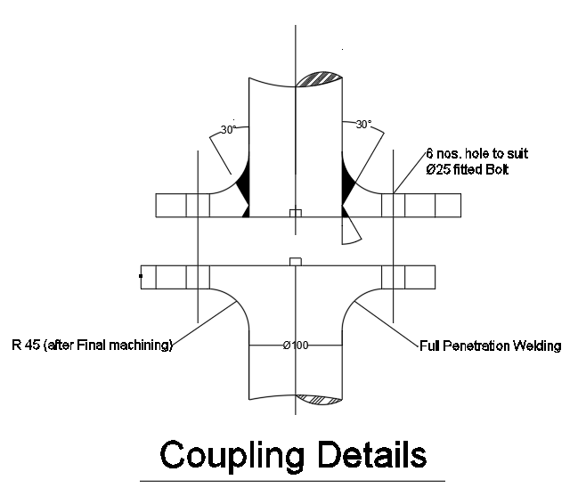
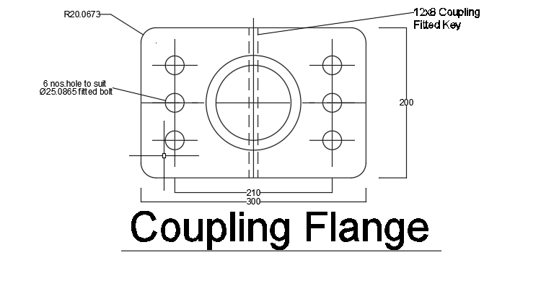
Details of Rudder Drawing

Slide 21
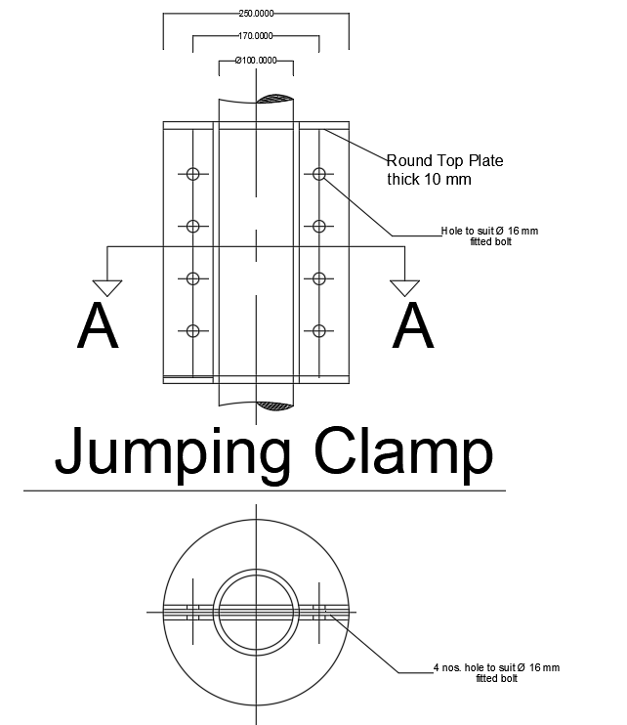
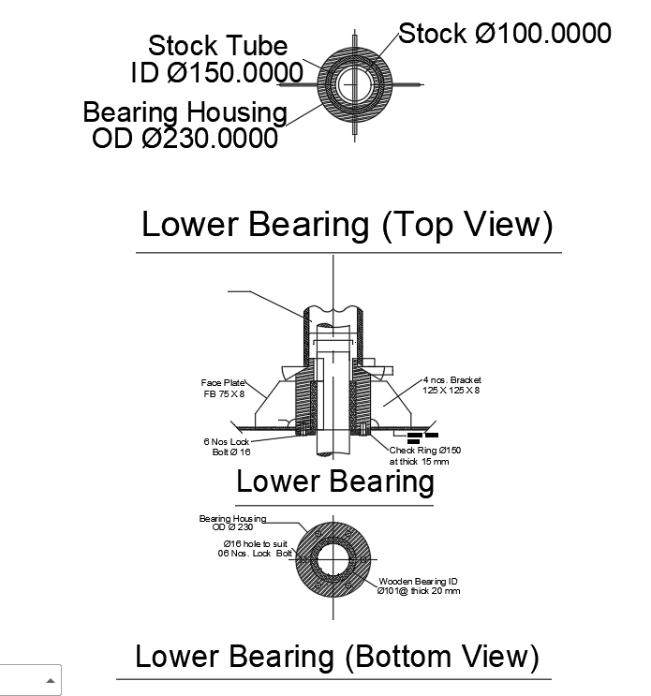
Details of Rudder Drawing

Slide 22
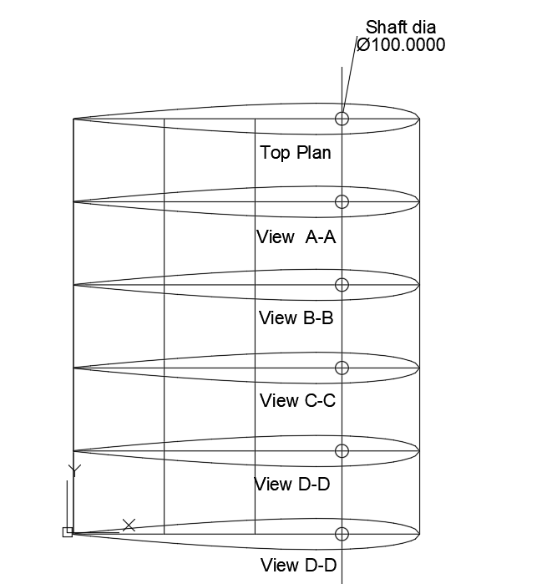
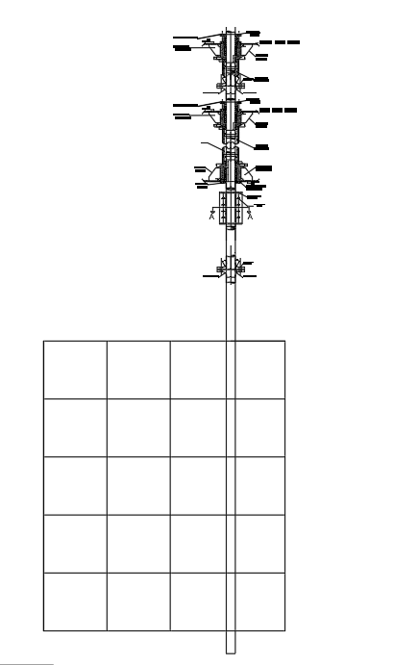
Details of Rudder Drawing
Profile View
NACA 0018 Sections

Slide 23
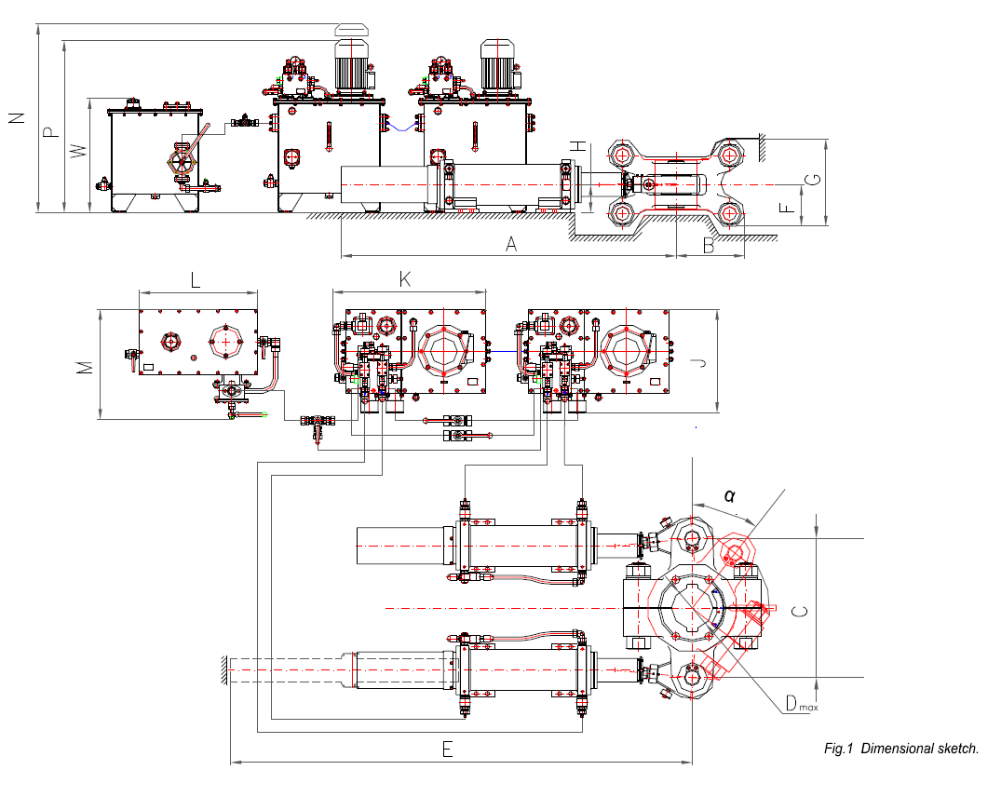
Steering Gear Arrangement
From 15.8 kN-m torque result steering gear chosen is Hydroster’s “MS Series Piston type hydraulic steering gear arrangement” .
And the design-model is “MS-25-35”. The model is as follows:

Slide 24
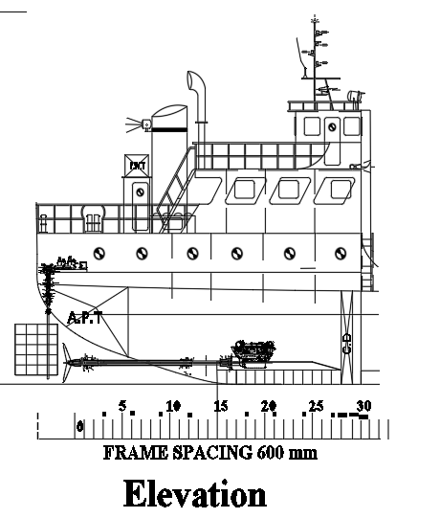
Profile View for Steering Gear:

Slide 25
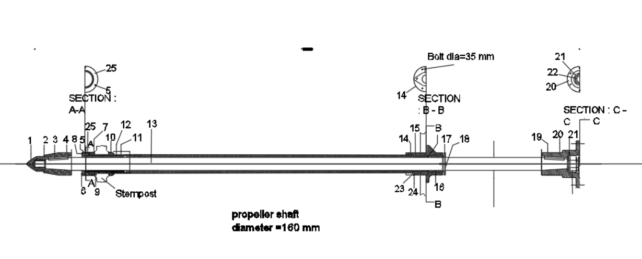
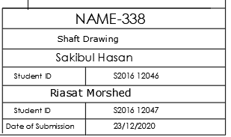
Shaft Arrangement

Slide 26
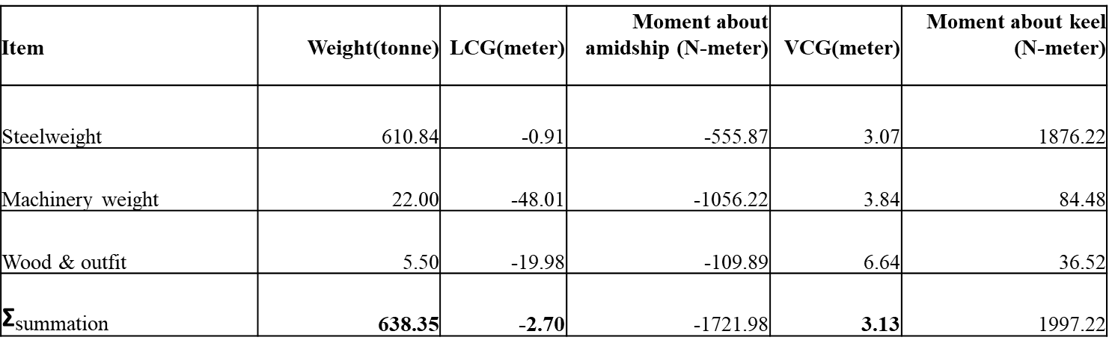
Summary of Lightweight
Item | Weight(tonne) | LCG(meter) | Moment about amidship (N-meter) | VCG(meter) | Moment about keel (N-meter)
Steelweight | 610.84 | -0.91 | -555.87 | 3.07 | 1876.22
Machinery weight | 22.00 | -48.01 | -1056.22 | 3.84 | 84.48
Wood & outfit | 5.50 | -19.98 | -109.89 | 6.64 | 36.52
$\text{Σ}$summation | 638.35 | -2.70 | -1721.98 | 3.13 | 1997.22

Slide 27
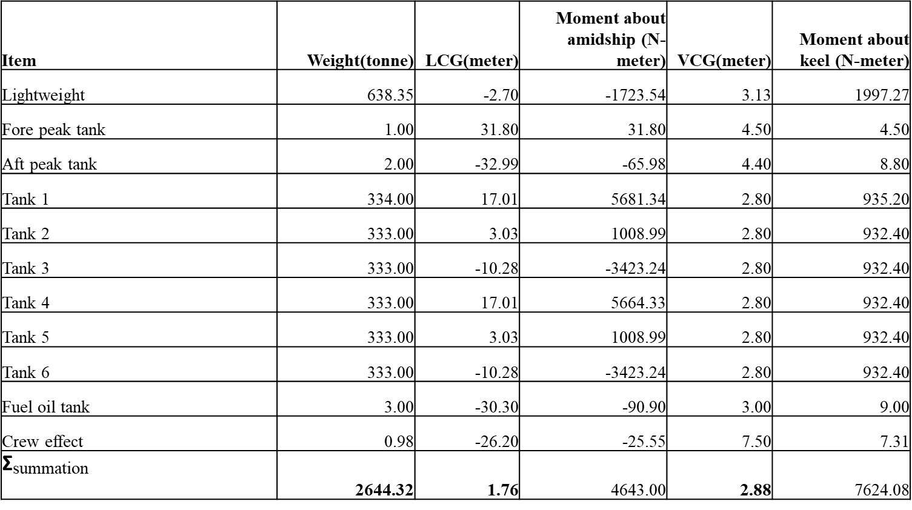
Summary of total weight
Item | Weight(tonne) | LCG(meter) | Moment about amidship (N-meter) | VCG(meter) | Moment about keel (N-meter)
Lightweight | 638.35 | -2.70 | -1723.54 | 3.13 | 1997.27
Fore peak tank | 1.00 | 31.80 | 31.80 | 4.50 | 4.50
Aft peak tank | 2.00 | -32.99 | -65.98 | 4.40 | 8.80
Tank 1 | 334.00 | 17.01 | 5681.34 | 2.80 | 935.20
Tank 2 | 333.00 | 3.03 | 1008.99 | 2.80 | 932.40
Tank 3 | 333.00 | -10.28 | -3423.24 | 2.80 | 932.40
Tank 4 | 333.00 | 17.01 | 5664.33 | 2.80 | 932.40
Tank 5 | 333.00 | 3.03 | 1008.99 | 2.80 | 932.40
Tank 6 | 333.00 | -10.28 | -3423.24 | 2.80 | 932.40
Fuel oil tank | 3.00 | -30.30 | -90.90 | 3.00 | 9.00
Crew effect | 0.98 | -26.20 | -25.55 | 7.50 | 7.31
$\text{Σ}$summation | 2644.32 | 1.76 | 4643.00 | 2.88 | 7624.08

Slide 28
Stability Calculation
GZ at Fully loaded condition:
Criteria | IMO value | WL 4(Fully loaded condition)
 |  | obtained value
Area up to 30 degree (m-rad) | ≥ 0.055 | 0.281
Area up to 40 degree (m-rad) | ≥ 0.09 | 0.397
GZ at 30 degree (m) | ≥ 0.2 | 0.78
Max. GZ at (degree) | ≥ 30 but not ≤ 25 | 30
Initial Metacentric Height (m) | Should not be ≤ 0.15 | 2.64
Heel angle(degree) | GZ(meter)
0 | 0.00
10 | 0.46
20 | 0.75
30 | 0.78
40 | 0.59
50 | 0.13
60 | -0.31
70 | -0.71
80 | -1.06
90 | -1.13

Slide 29
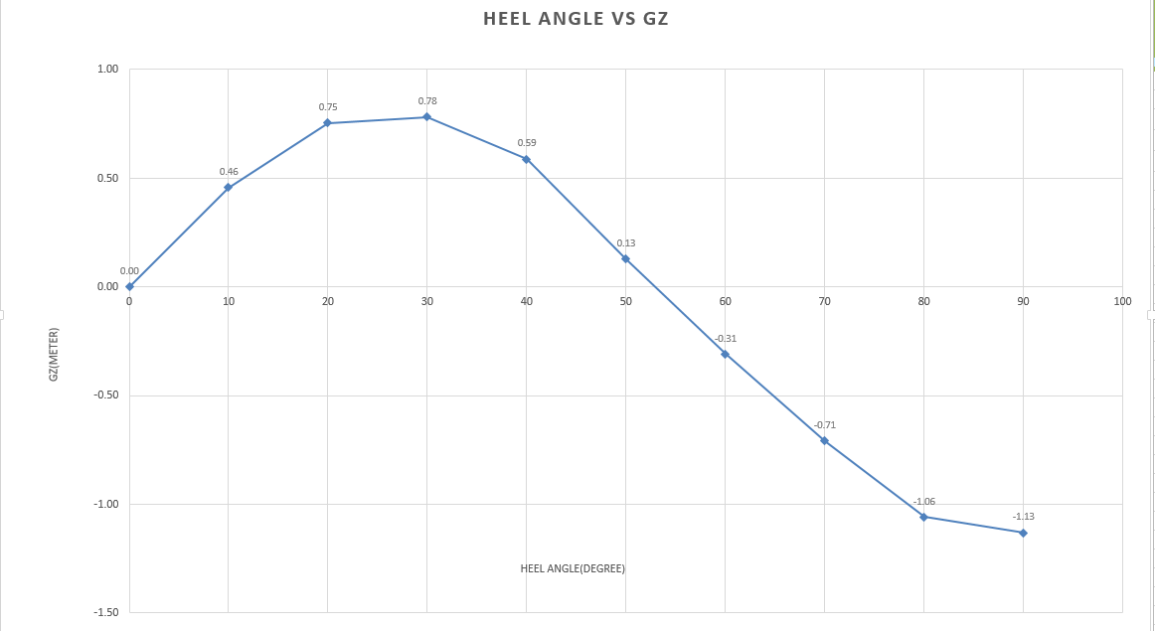
GZ curve:

Slide 30
Trim Calculation
Full load condition |  | Value |  | Unit |  | No load condtion | Values | Unit
Displacement |  | 2659 |  | tonne |  | Displacement | 659 | tonnes
Length overall, L_{OA} |  | 73.75 |  | m |  | Length overall, L_{OA} | 73.75 | m
Draft, T |  | 4.4 |  | m |  | Draft | 1.1 | m
LCG |  | 1.77 |  | m |  | LCG | -2.7 | m
LCB |  | 0.43 |  | m |  | LCB | -0.11 | m
MCT 1cm |  | 57.23 |  | tonne - m |  | MCT 1cm | 52.97 | tonne - m
C_{F} |  | -1.33 |  | m |  | C_{F} | -0.17 | m
Trim |  | 0.62 |  | m |  | Trim | 0.31 | m
Aft trim |  | 0.30 |  | m |  | Aft trim | 0.16 | m
Fore trim |  | 0.32 |  | m |  | Fore trim | 0.16 | m
Aft draft |  | 4.70 |  | m |  | Aft draft | 1.26 | m
Fore draft |  | 4.08 |  | m |  | Fore draft | 0.94 | m
The ship is trimmed by stern

Slide 31
Thank you

